Slide 1
Bouncing droplets
Sweden

Slide 2
Bouncing Waterdroplets
”Investigate the motion of water droplets falling on a hydrophobic surface (e. g. coated with soot or teflon).”

Slide 3
Overview of presentation
Introduction to the phenomenon
Summary of investigations
Experimental set-up
Results
Conclusion

Slide 4
Bouncing waterdroplet

Slide 5
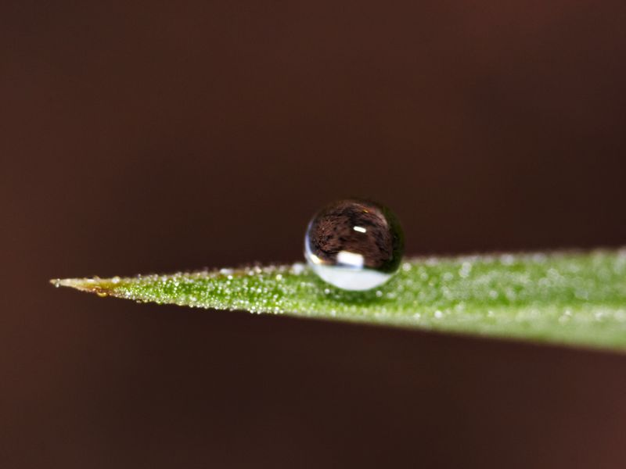
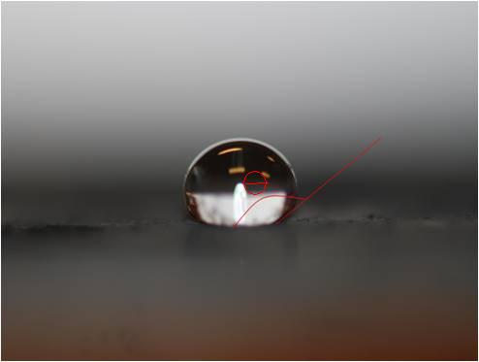
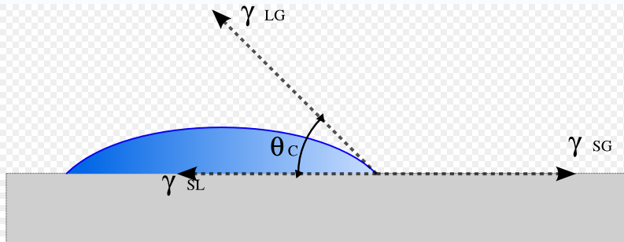
Hydrophobic Surface
If Ѳ > 90˚→ the surface is hydrophobic
This due to a difference in chemical
structures
This sooted surface has approximately
a contact angle of 145˚

Slide 6
Investigations
”Investigate the motion of water droplets falling on a hydrophobic surface”
What can be changed
What will it affect
Height of release
Yet to be investigated
Radius
Density
Surface tension
Number of droplets formed
Conservation of kinetic energy , surface tension – Weber number
Yet to be investigated
Velocity
Height of bounce
Energy loss
Contact time

Slide 7
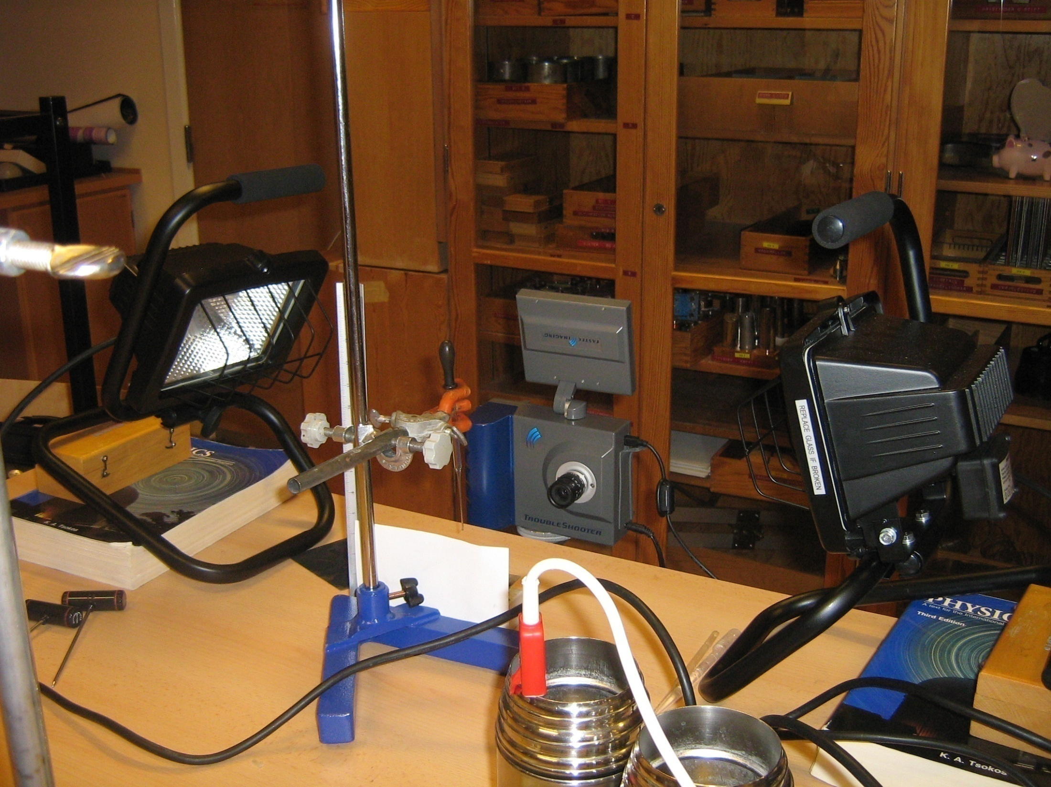
Material
High speed camera
Spotlights
Stand
Water in a pipette
Soot coated aluminium plate
Notes:
Blanka tll nästa: fixa bild rig

Slide 8
Behaviour of droplet at the hydrophobic surface
Depending on the speed and the formation of the droplet different things will occur when the droplet hits the hydrophobic surface.
Five major categories can be observed:
- One clean bounce
- Bounce with strain
- One large and one small droplet
- One large and a few small droplets
- Many droplets, ”splash”

Slide 9
One Clean Bounce
Kinetic energy due to velocity causes the droplet to expand
Surface tension affects in the opposite direction → strives for the water molecules to be as close as possible
Therefore, when the surface area gets larger energy is stored causing the bounce when the molecular forces (caused by surface tension) pulls the waterdroplet back

Slide 10
Bounce with Strain

Slide 11
Weber Number
Comparison between the kinetic energy and the surface tension of the droplet can help us understand what effect the different energies and parameters will have on the droplet when hitting the surface.
results in We having a dimensionless number, the value will have no unit
Used to confirm that surface tension affects whether it will be a bounce or a splash
Notes:
Explain parameters symbols

Slide 12
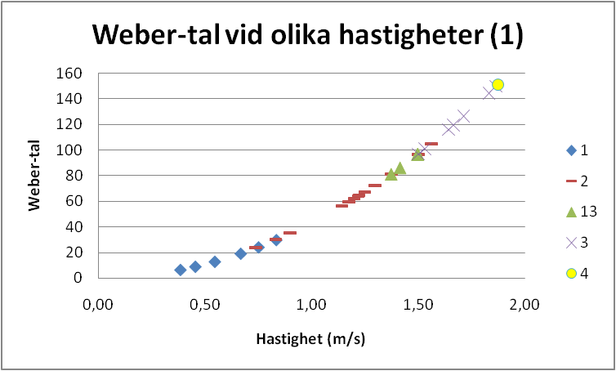
Weber Number
Weber-Number at different Velocities
1 .Clean Bounce
2. Bounce with strain
3. One large one small
4. One large, few small
5. Many
Velocity
We < 40 = Bounce We > 140 = Splash

Slide 13
Conclusion
”Investigate the motion of water droplets falling on a hydrophobic surface (e. g. coated with soot or teflon).”
Weber number is a well functioning measure when determining how the droplet will behave when hitting the surface. We < 40 = ”Bounce”, We > 140 = ”Splash” it also provides us with a proof for the importance of the surface tension of the water.

